Slide 1
IMPACTS OF TECHNOLOGY
by Diep Vu (Emma)

Slide 2
CONTENTS
How does technology affect our lives?
2. Social, economic, ethical, cultural and other impacts of technology

Slide 3
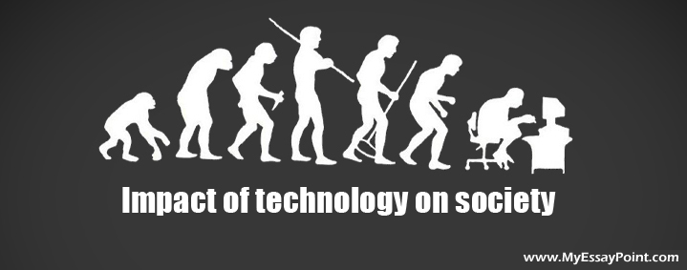
1. Technology effects

Slide 4

1. Technology effects
Notes:
Citation to video: https://www.youtube.com/watch?v=9Y_e0ZZ2BKo

Slide 5

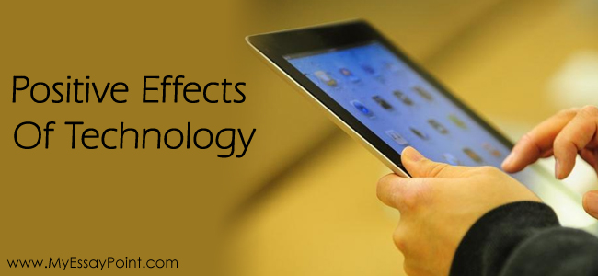
1. Technology effects
A. Positive

Slide 6


1. Technology effects
Improved Communication:
New methods of communication: emails, social networking websites, FaceTime, etc.
Benefits: time-saving, elimination of geographical distance, expansion of personal relationships, widened business connection, etc.

Slide 7
1. Technology effects
Convenience in Education:
Mostly free access to huge amounts and different forms of information: books, images, videos, audio, etc.
The rise of free online courses enable students to learn from any place at any time in the world.
Computer incorporation in class helps students learn more effective with visualization, online discussions, and easier homework submission.

Slide 8

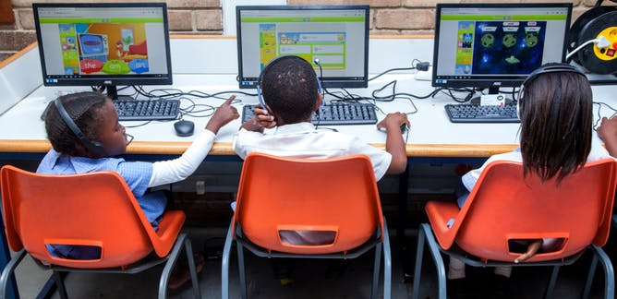
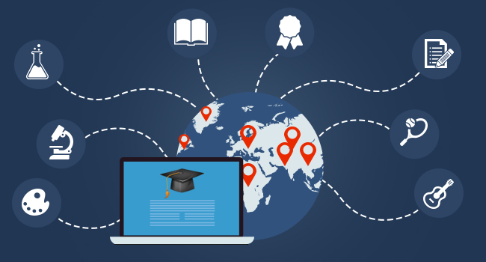
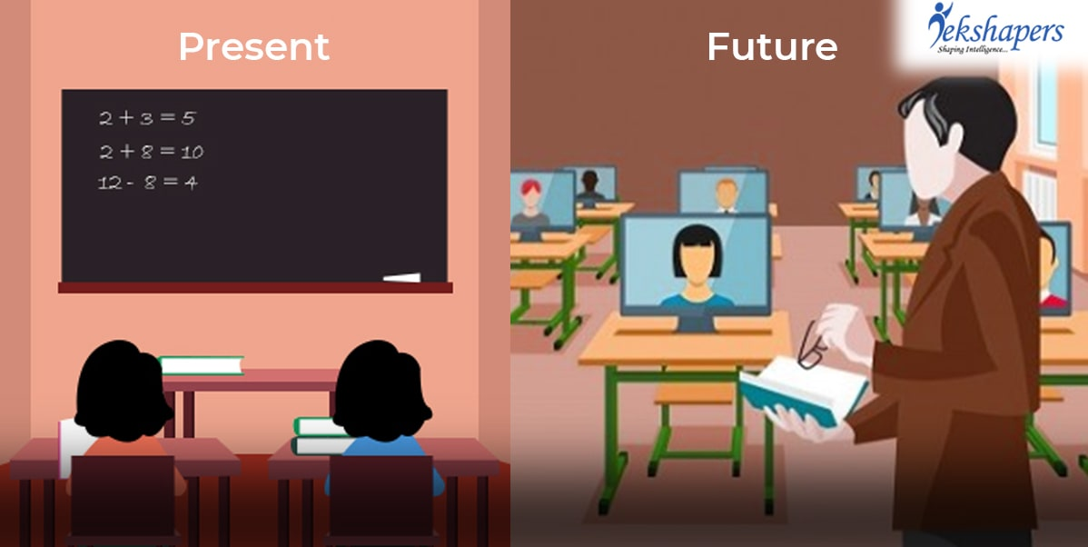
1. Technology effects

Slide 9
1. Technology effects
Easy Travel:
Computer makes it easier to book tickets online and do calculations to optimize our options of traveling.
GPS and map application enable us to go virtually anywhere in the world without risks. They also can predict time required, traffic conditions, weather status and give accurate directions by using satellite.

Slide 10
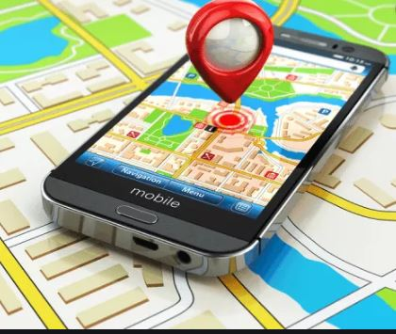


1. Technology effects

Slide 11

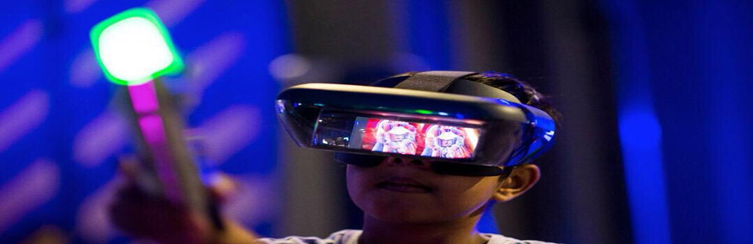
1. Technology effects
Entertainment:
Computers enable us with a wider range of entertainment such as interactive games, movies, etc.

Slide 12
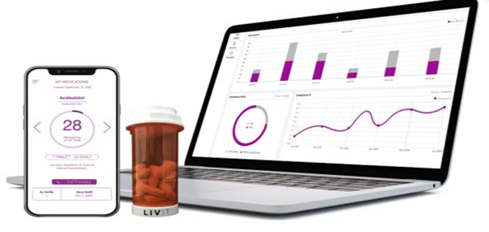

1. Technology effects
Medication:
Doctors can keep track of your health records by storing them in computers and give more accurate diagnosis or treatment with the aid of advanced technology. You can also find prevention or cure and search for symptoms online while sitting at home.

Slide 13
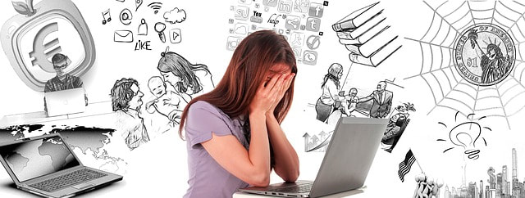

1. Technology effects
B. Negative

Slide 14
1. Technology effects
Sleep deprivation and decreased physical health:
Constant exposure to blue screens lead to lack of sleep, which will generate the sleep chemical melatonin. This substance will affect detrimentally to your brain functions, interfere with your biological clock and harm your physical health with back and neck pains, myopia, obesity, stress, etc.

Slide 15

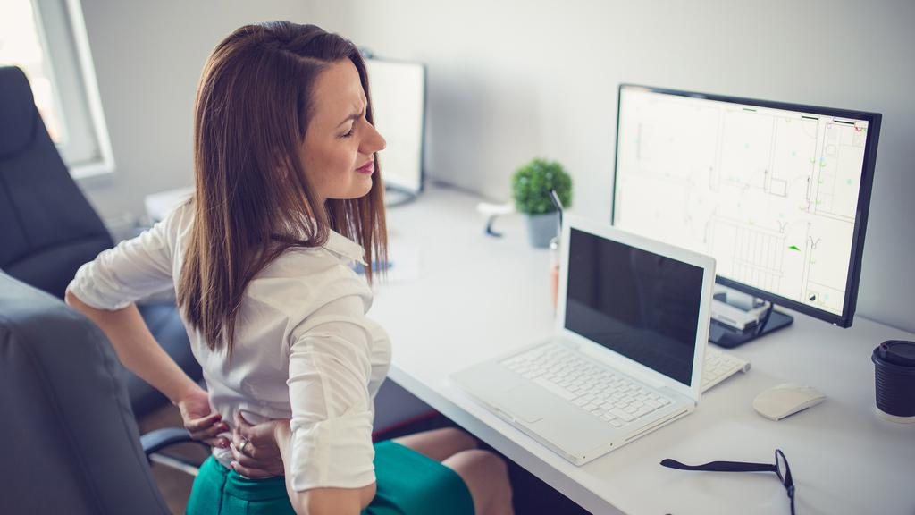
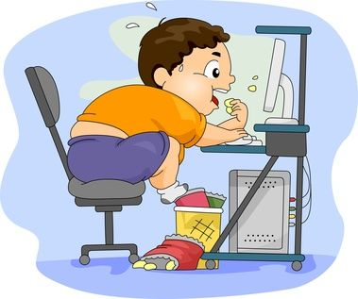
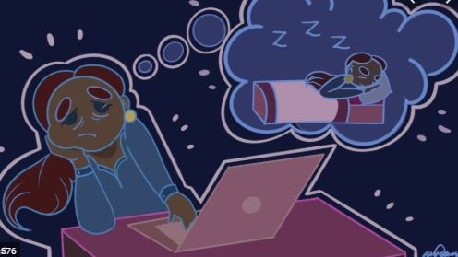
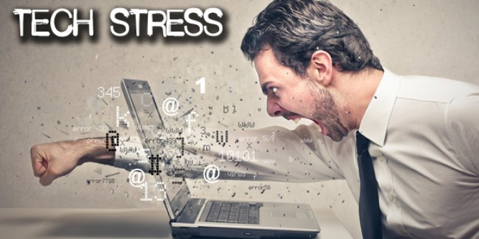

1. Technology effects

Slide 16
1. Technology effects
Time-consuming and addicting:
Addiction to online computer games seems to be a growing problem in Asian countries. China and South Korea have both had incidents in which someone died after playing games nonstop for an incredibly long period, sometimes two days or more. A man in China died after a three-day gaming binge at an Internet café (where most online gaming in Asia seems to take place) in 2007 [1].
Notes:
[1]: https://www.cnn.com/2015/01/19/world/taiwan-gamer-death/index.html

Slide 17

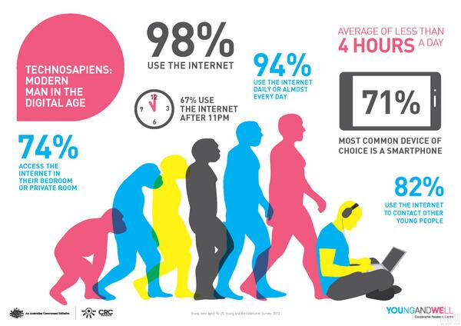

1. Technology effects

Slide 18
1. Technology effects
Environmental problem:
The production of computer hardware and cleaning substances cause great hazard to the environment. The amount of electricity that is generated from computers being turned on for hours could even light the Eiffel Tower 24 hours a day for 720 years. This pollution also results in enormous economic problems as well as health problems. [2]
Notes:
[2]: http://samedaypapers.me/the-effects-of-computers-on-the-environment/

Slide 19
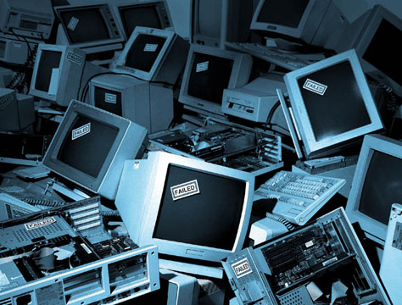
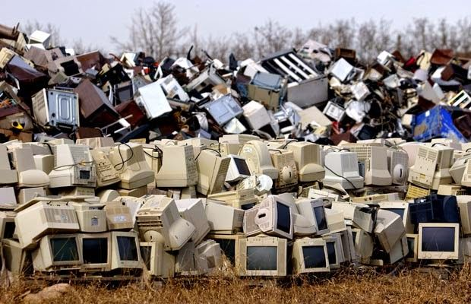
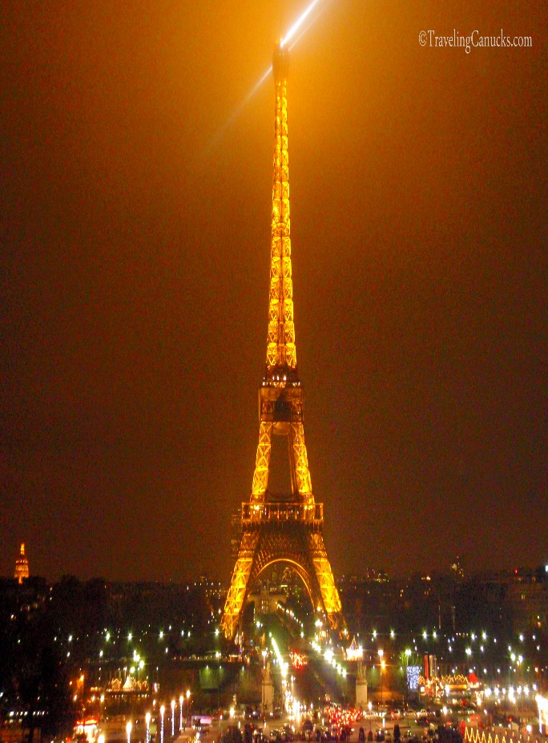
1. Technology effects

Slide 20
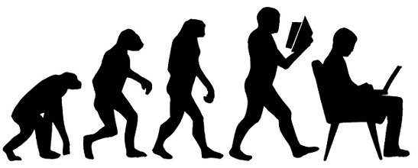
2. Other impacts

Slide 21

2. Other impacts
Economy
The most profound impact is increase in productivity. The good is produced at less cost which generates more supply, increases employee’s wages and reduces market prices.
However in the short term, computers will make certain people’s jobs unnecessary, which raises unemployment rate.

Slide 22
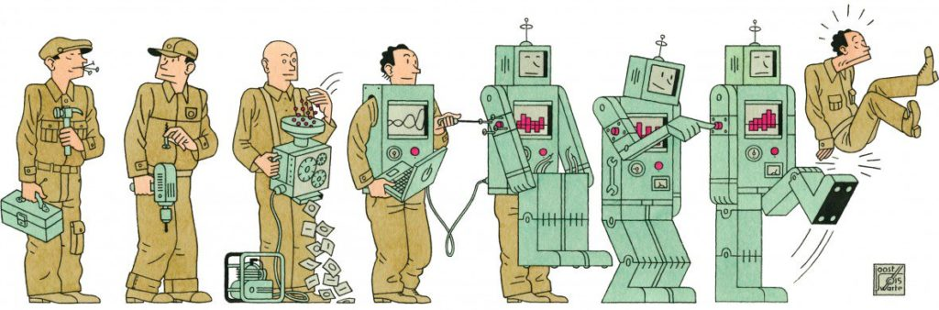
2. Other impacts

Slide 23
2. Other impacts
Society:
Even though more people are connected, they sometimes may feel isolated from the real world because computers have made human interaction and social skills seem irrelevant. People then struggle with voicing their thoughts because it is easier to sit in front of the screen and type whatever you want without being judged and worried the others’ reactions.

Slide 24

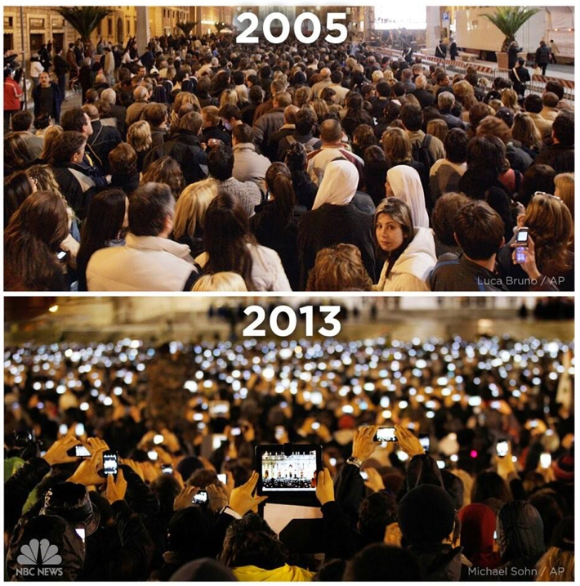
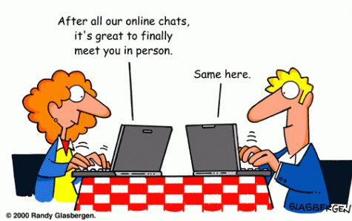
2. Other impacts

Slide 25
2. Other impacts
Privacy and Security:
If being misused, technology can pose a number of risks such as cyberbullying, scam, sexting. 39% of teens admitted sending sext messages, and almost half of the teenagers received texts containing nudity. [3]
It is easier to find someone’s personal information within a few clicks on Facebook and the information obtained can be used for hacking and viruses.
Notes:
[3]: https://auntyfaith.com/2019/02/28/top-5-negative-effects-of-technology-on-young-people/

Slide 26
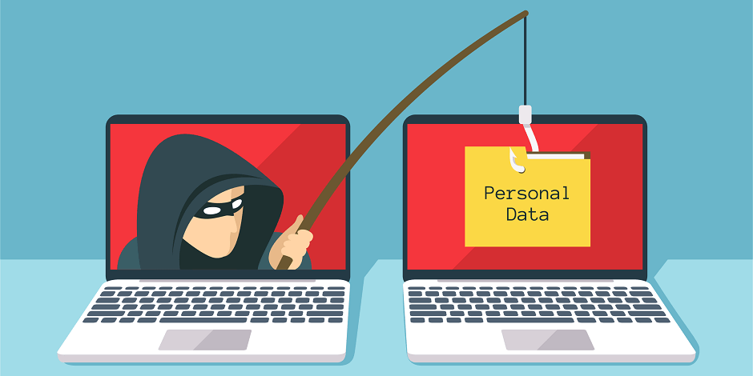
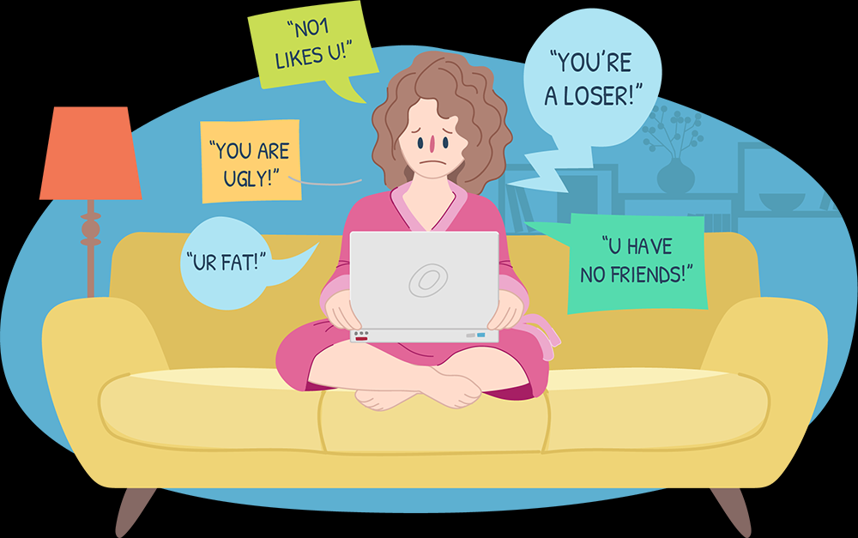

2. Other impacts

Slide 27
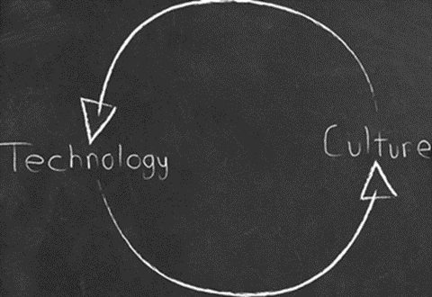

2. Other impacts
Culture diversity:
Computers help you learn more about other cultures within a search on YouTube. You can reach out to friends around the world, from different cultures by using social platforms.
Technology also change our reading culture by offering new forms of reading materials available.

Slide 28

Notes:
“I affirm that I have carried out my academic endeavors with full academic honesty.“ [Signed, Diep Vu]

